Slide 1


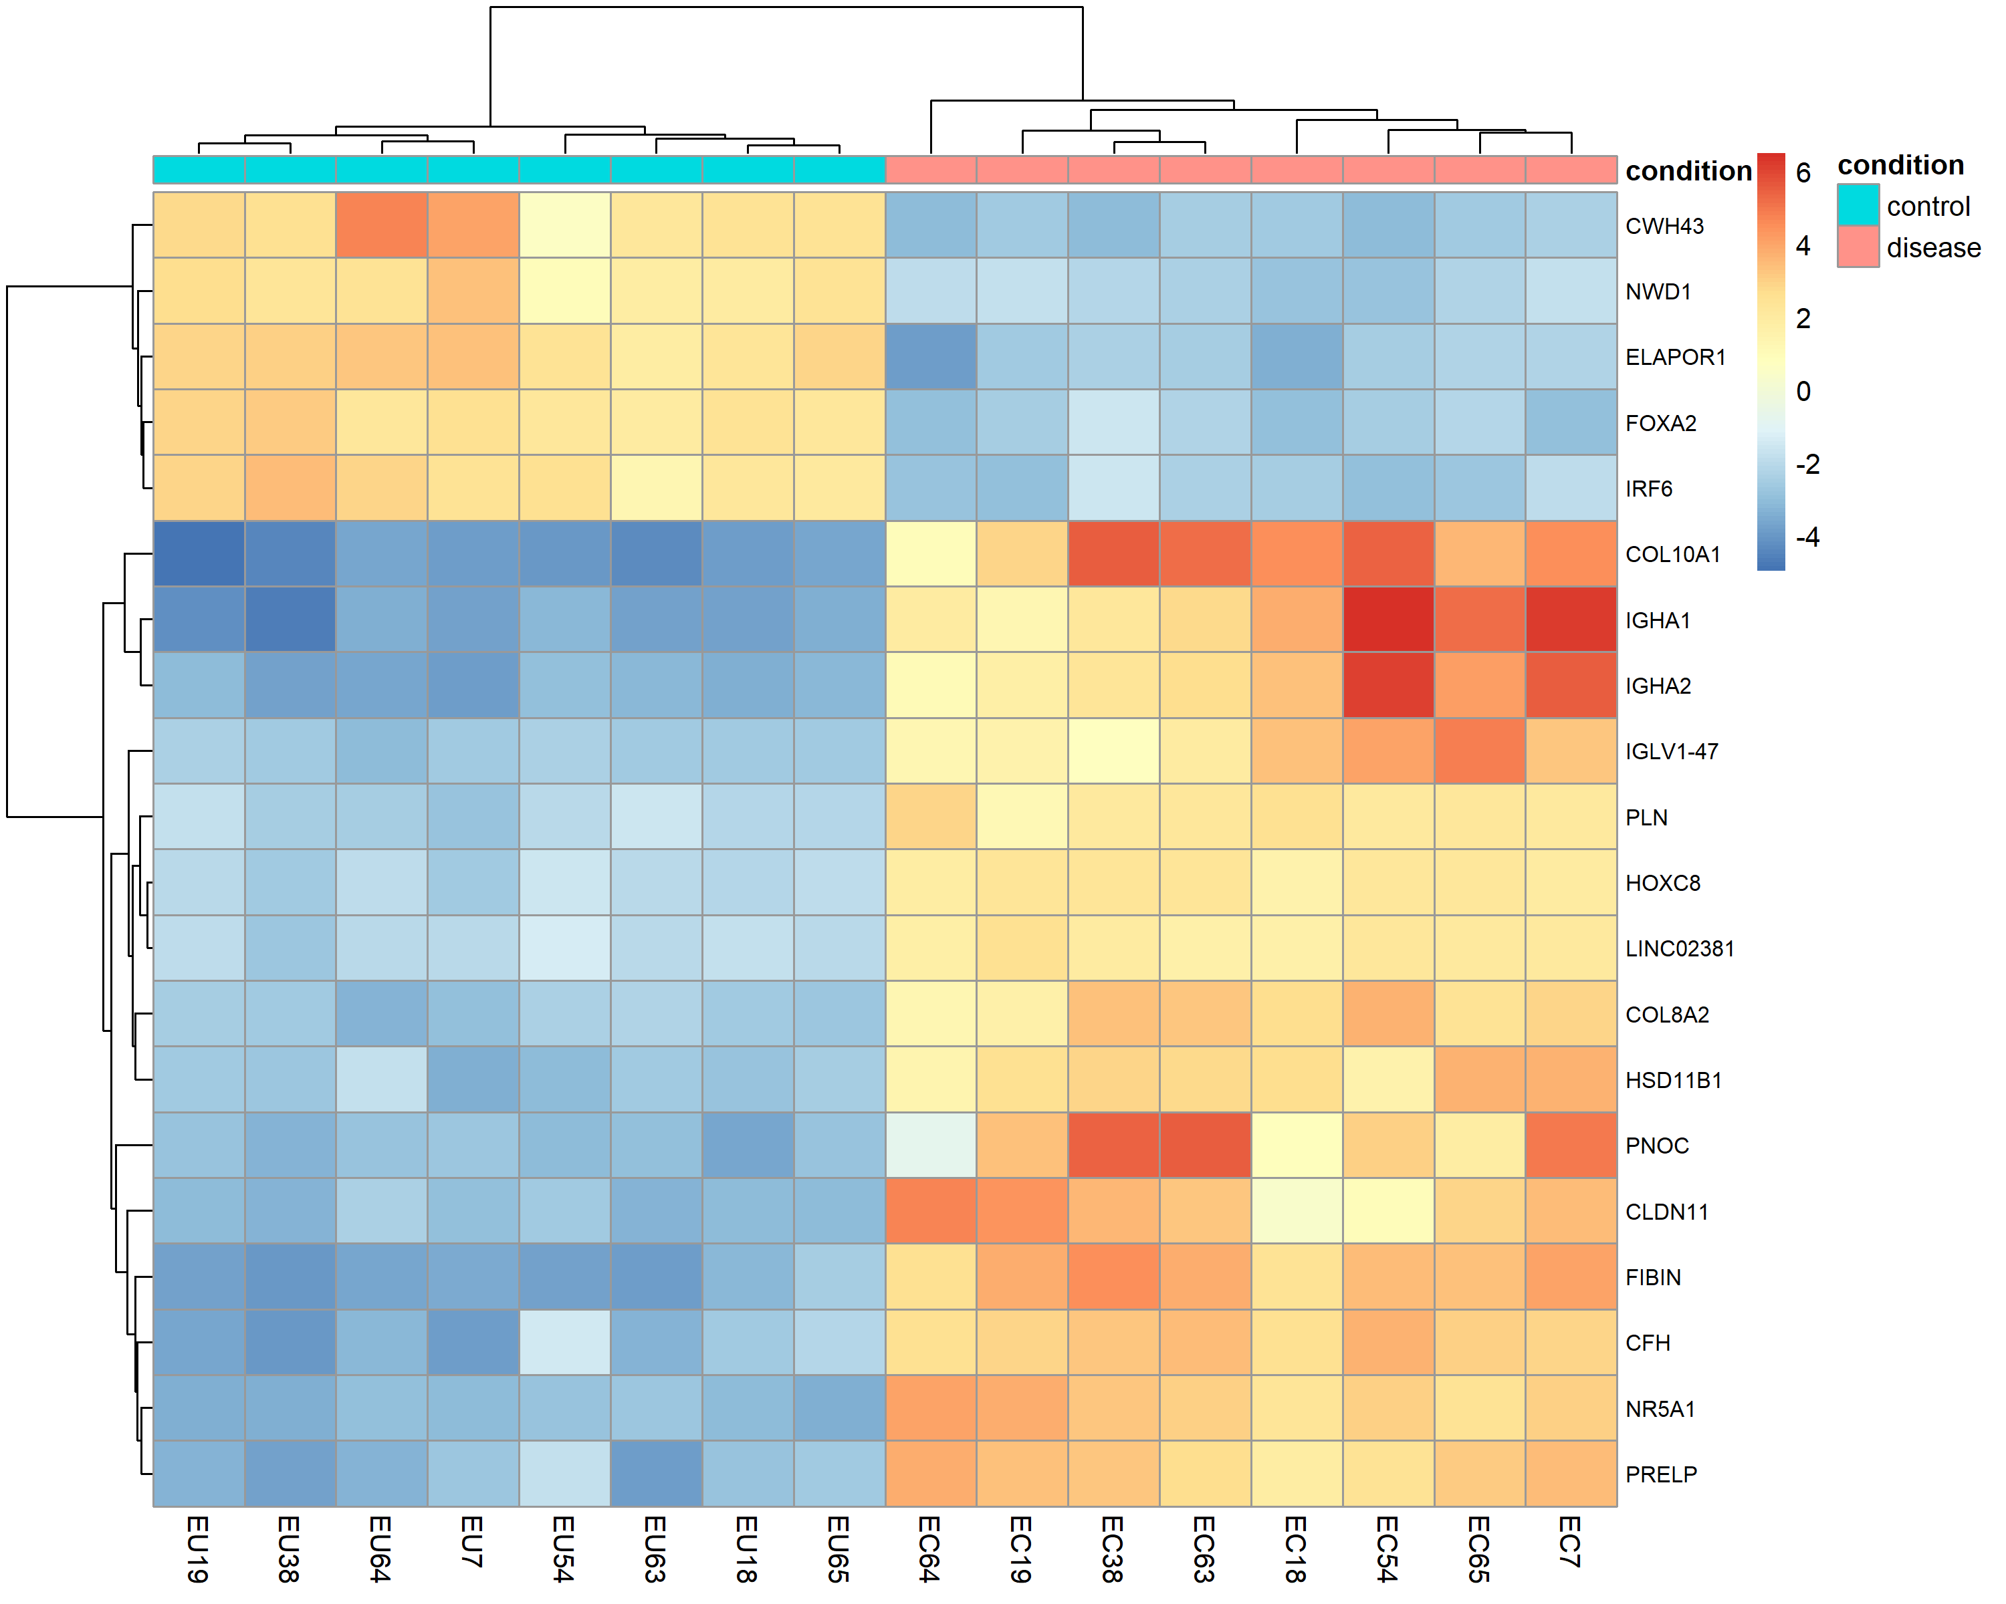
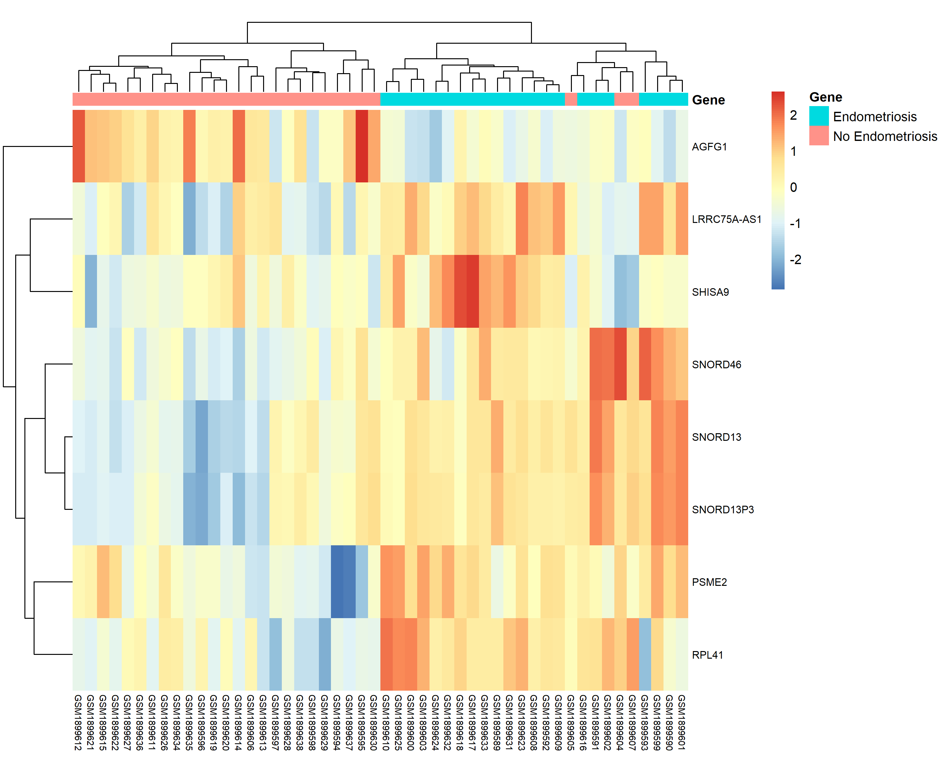
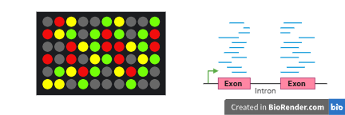
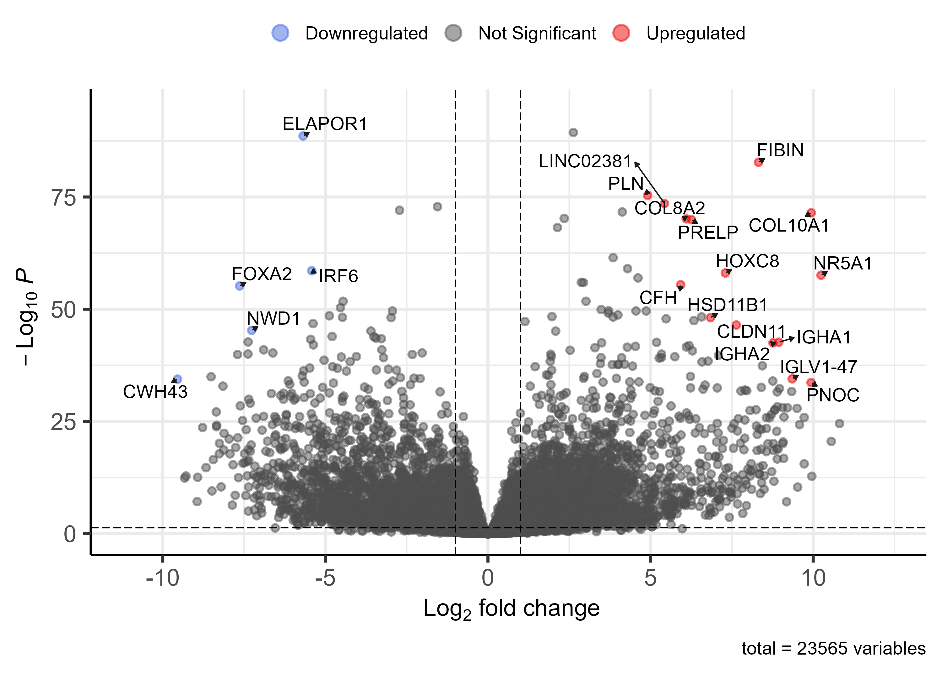
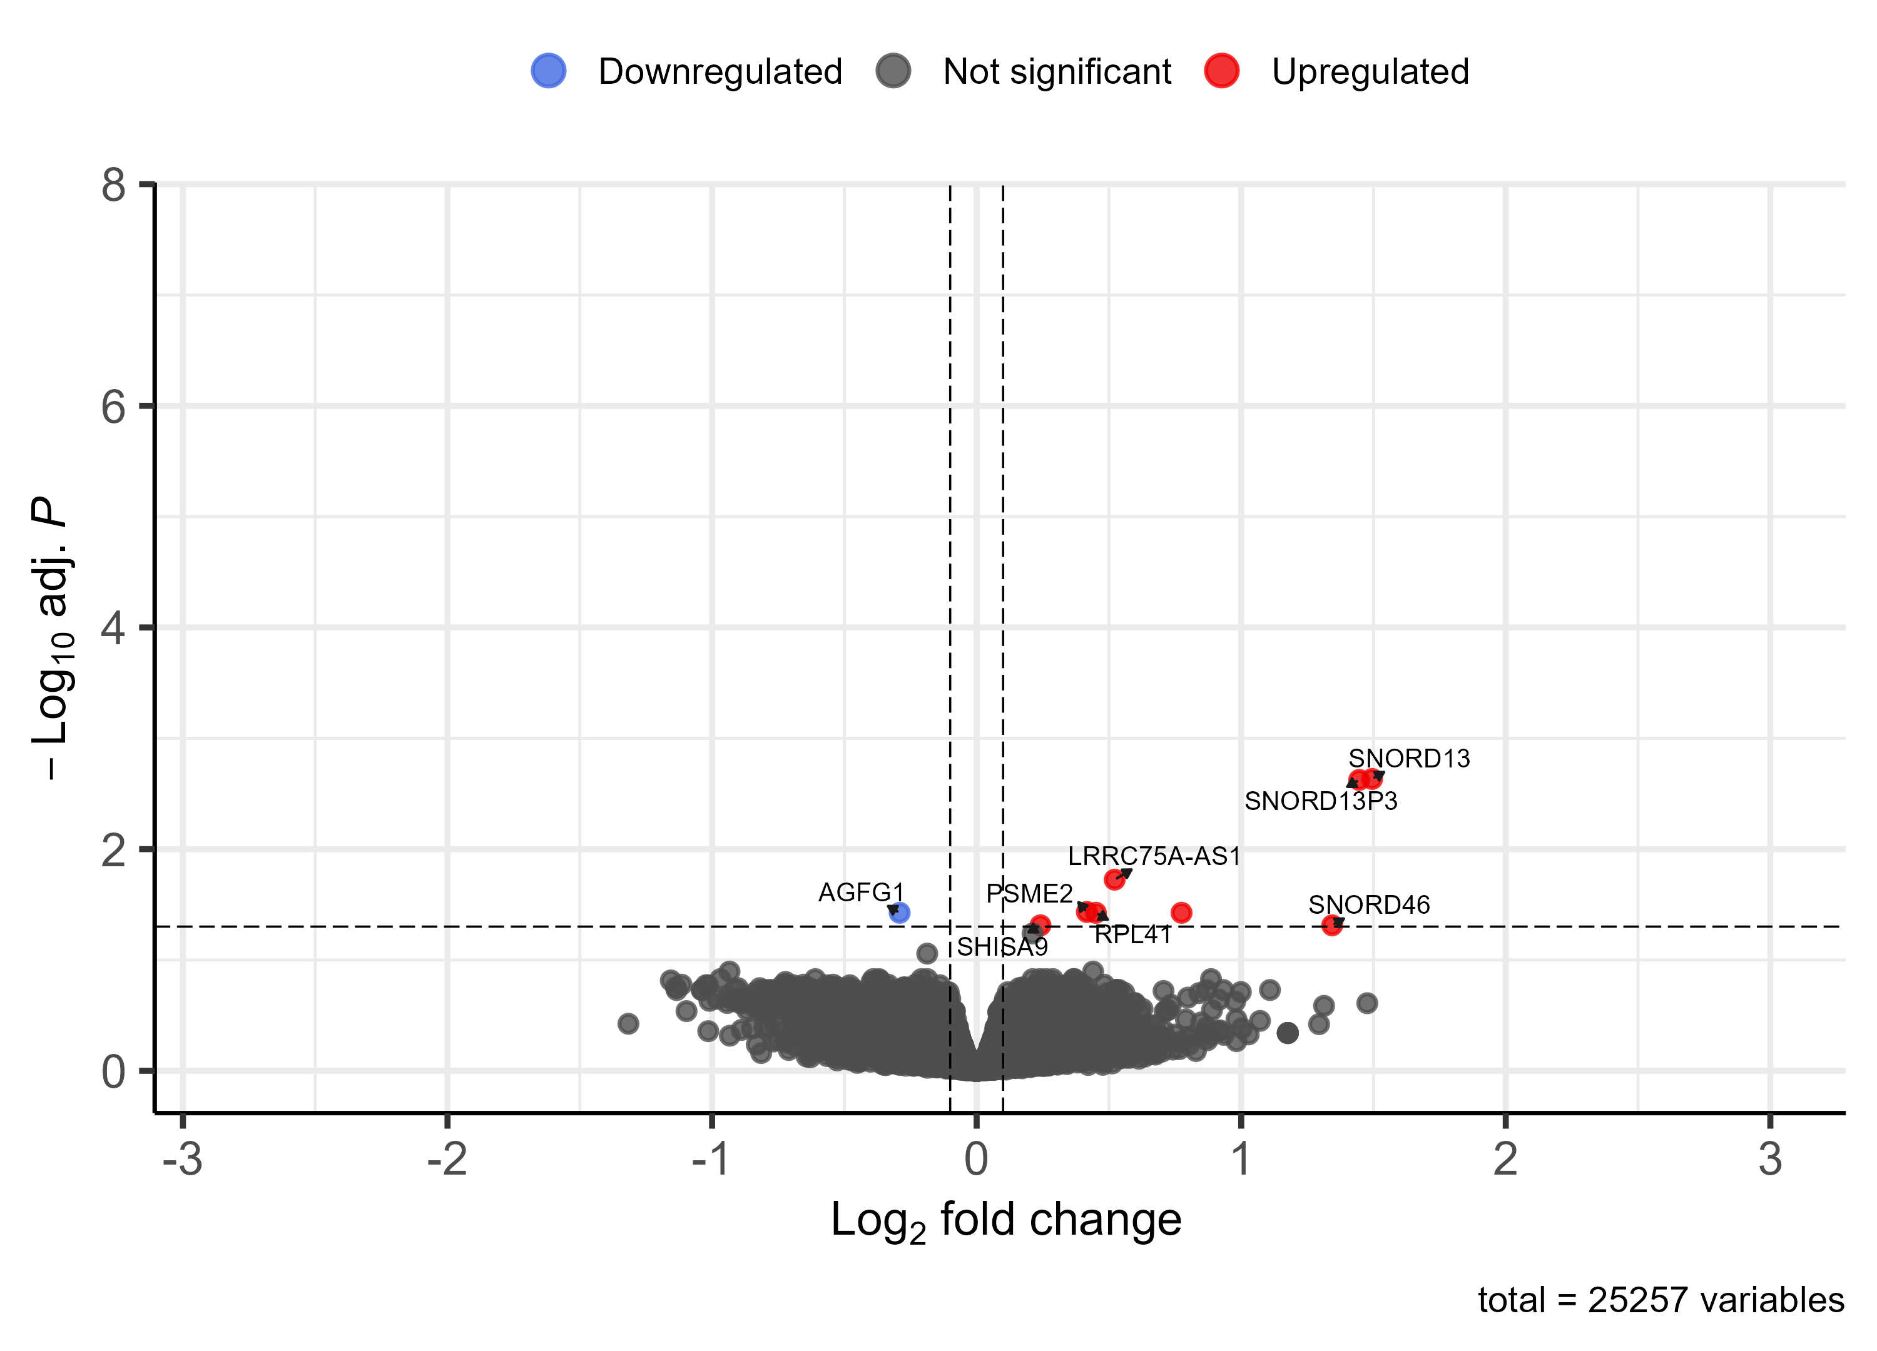
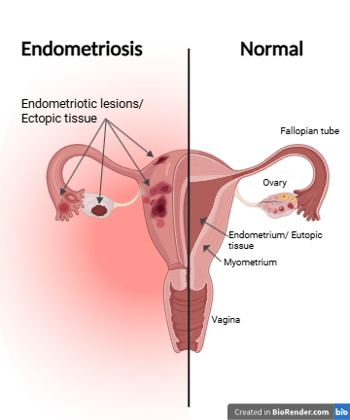
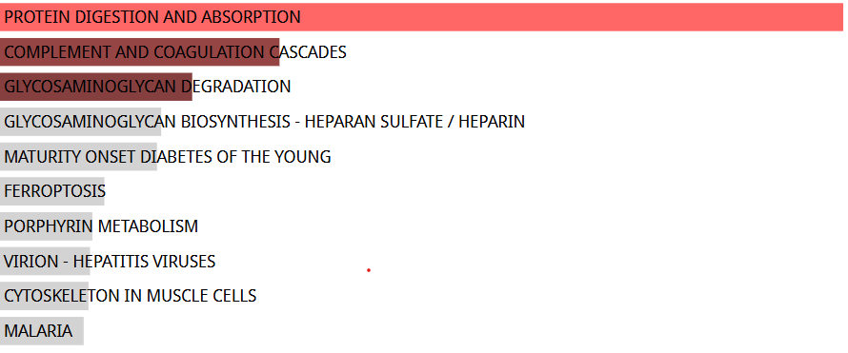
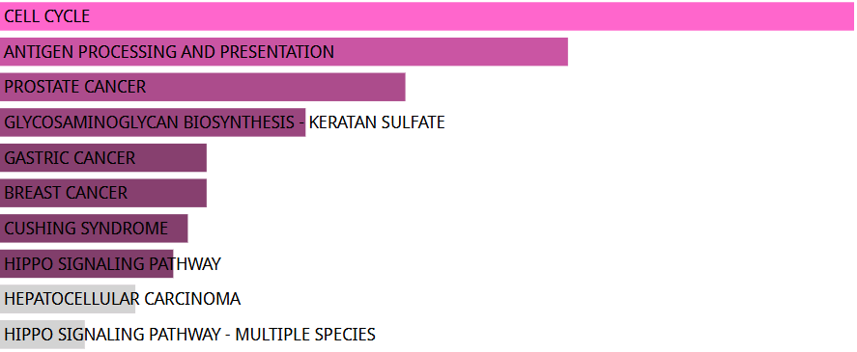
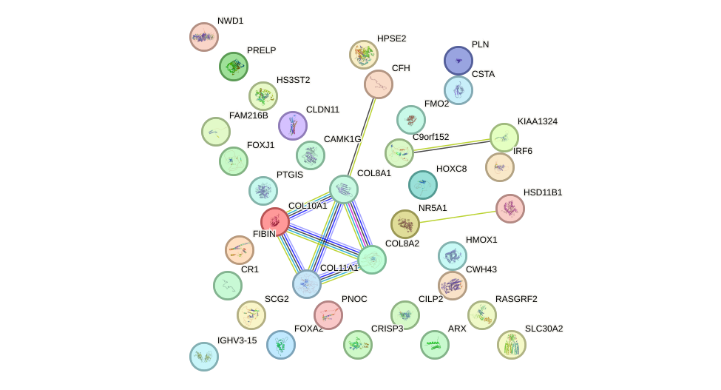
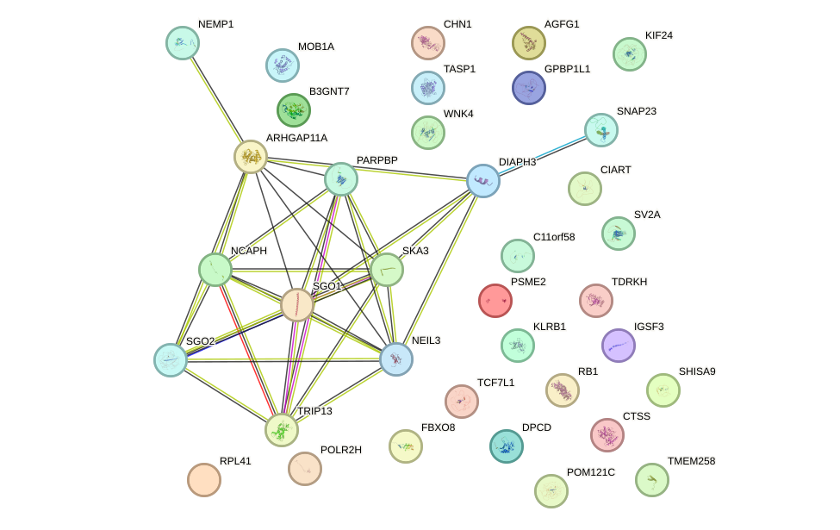
Uncovering Potential Actionable Biomarkers for Endometriosis using Differential Gene Expression Analysis
Amira Bach, Sweta Rai, Igor Kovalchuk
Department of Biological Sciences, University of Lethbridge, 4401 University Drive, Lethbridge, Alberta, Canada, T1K 3M4
Methodology
Department of Biomolecular Sciences, University of Lethbridge, 4401 University Drive, Lethbridge, Alberta, Canada, T1K 3M4
Abstract
Micro array data:
Differential analysis
Make contrast and design matrices
Use limma package to fit data to statistical model using logFC >0.1 and adjusted P value<0.05
Discussion
Endometriosis is a long-term disease that has no known cause, and limited treatment option. The objective of this project was to identify differentially expressed genes (DEGs) that could potentially act as actionable biomarkers for endometriosis. In this project transcriptomic data, sourced from Gene Expression Omnibus (NCBI GEO), using both microarray (GSE73622) and RNA sequencing (RNA-seq) (GSE105764) were analyzed using bioinformatics approaches to compare two related but distinct biological contrasts: ectopic vs. eutopic tissue (RNA-seq), and specific cells within those tissues, endometrial mesenchymal stem cells (eMSC) and endometrial stromal fibroblasts (eSF) in endometriosis vs. control (microarray). The two datasets operate at different levels, tissue level and cell level, so DEGs were analyzed independently. Differential expression was visualized using volcano plots and heatmaps. Pathway enrichment and protein-protein interaction (PPI) analyses were also performed. DEGs were then validated against known potential biomarkers for endometriosis.
Download data
NCBI GEO
Data came normalized. GeneSpring software using RMA.
Data preparation
Remove low variance probes and fill NaN values with median
Annotate with gene symbol
Group data
Visuals and downstream analysis
Make heatmaps and volcano plots with top DEGs to view results.
KEGG analysis was performed using EnrichR
PPI was made using STRING
DEGs were validated with known Endometriosis biomarkers
During this analysis, out of 25,257 genes, microarray data identified 8 upregulated genes and 1 downregulated gene. On the other hand, with the same cutoffs , out of 23,565 genes RNA-seq data identified 6561 upregulated genes, with COL10A1 and FIBIN as the top two, and 6868 downregulated genes, with ELAPOR1 and FOXA2 as the top two. Kyoto Encyclopedia of Genes and Genomes (KEGG) pathway enrichment analysis reveals the connection significant genes have on other pathways in our body. Within the RNA-seq dataset, genes strongly associated with these enriched pathways that also met significance thresholds included COL10A1, FOXA2, CFH, and CR1. Notably, COL10A1, CFH, and FOXA2 are established potential biomarkers for endometriosis (Chen, et al., 2026), (Bae, et al., 2022), (Lin, et al., 2018), supporting the biological validity of the ectopic vs Eutopic tissue analysis. PPI network analysis using STRING illustrated the functional interactions between these genes. Notably, there was no overlap in DEGs between the two datasets, likely due to differences in the tissue and cell types each was derived from. Collectively, these findings suggest that the identified genes may serve as potential actionable biomarkers to support future precision medicine approaches for endometriosis.
RNA seq data:
Differential analysis
Using DEseq2 package to build DEseq object
remove genes with low counts and set factor level
PCA
Annotate with gene symbol
Analyze data with DEseq2 package, use LogFC cutoff >0.1 and adjusted P value <0.05
Download data and preparation
NCBI GEO
Make count matrix
Group data
Results
Department of Biomolecular Sciences, University of Lethbridge, 4401 University Drive, Lethbridge, Alberta, Canada, T1K 3M4
RNA Sequencing
Microarray
ATGCAG
Figure 1. (a) for microarray and (b) RNA-seq
Introduction
Endometriosis occurs when tissue similar to the lining of the uterus grows outside the uterus. These growths are called lesions, or ectopic tissue. Ectopic tissue is composed of blood and multiple cell types, including eMSC and eSF. Current treatments for endometriosis focus on managing symptoms rather than alleviating the problem itself. These treatments, hormone medication and surgery, are often inadequate, as pain commonly returns after stopping medication, and surgery can sometimes only give temporary relief. This happens because endometriosis is a complex, heterogeneous disease whose phenotype ranges from person to person. The need for precision medicine in endometriosis is significant, but it relies on the discovery of actionable biomarkers, making it a hard goal to reach. The goal of this study is to identify potential actionable biomarkers at the transcriptomic level that could later be used in precision medicine.
Conclusion
This differential gene analysis has reveled 4 significant genes that may become potential actionable biomarkers, assisting precision medicine in endometriosis.
Figure 4.1. Top 20 DEGs in Ectopic vs Eutopic heatmap
Figure 4.2. DEGs in Endometriosis vs Control heatmap
Future direction
Next steps would include, using machine learning models to validate findings on bigger data sets. Next, look these genes, looking at expression rates on all levels of omics. Then, wet lab experiments to test biomarkers.
References
Barragan F, Irwin JC, Balayan S, Erikson DW, Chen JC, Houshdaran S, Piltonen TT, Spitzer TL, George A, Rabban JT, Nezhat C, Giudice LC. (2016). Human Endometrial Fibroblasts Derived from Mesenchymal Progenitors Inherit Progesterone Resistance and Acquire an Inflammatory Phenotype in the Endometrial Niche in Endometriosis [Data set]. https://pmc.ncbi.nlm.nih.gov/articles/PMC4939744/
Zhao L, Gu C, Ye M, Zhang Z, Li L, Fan W, Meng Y. (2018). Integration analysis of microRNA and mRNA paired expression profiling identifies deregulated microRNA-transcription factor-gene regulatory networks in ovarian endometriosis [Data set]. https://pmc.ncbi.nlm.nih.gov/articles/PMC5776778/
Slikker W Jr. (2018). Biomarkers and their impact on precision medicine. https://pmc.ncbi.nlm.nih.gov/articles/PMC5813864/
Chen, X., Cheng, L., Cheng, M. et al.(2026) Identifying Predictive Biomarkers and Immune Infiltration Features in Endometriosis. https://link.springer.com/article/10.1007/s43032-026-02081-z
Bae SJ, Jo Y, Cho MK, Jin JS, Kim JY, Shim J, Kim YH, Park JK, Ryu D, Lee HJ, Joo J, Ha KT. (2022). Identification and analysis of novel endometriosis biomarkers via integrative bioinformatics. https://pmc.ncbi.nlm.nih.gov/articles/PMC9630743/
Lin A, Yin J, Cheng C, Yang Z, Yang H. (2018). Decreased expression of FOXA2 promotes eutopic endometrial cell proliferation and migration in patients with endometriosis. https://www.sciencedirect.com/science/article/pii/S1472648317306168
Giudice LC, Oskotsky TT, Falako S, Opoku-Anane J, Sirota M. (2023). Endometriosis in the era of precision medicine and impact on sexual and reproductive health across the lifespan and in diverse populations. https://pmc.ncbi.nlm.nih.gov/articles/PMC10503213/
Hypothesis: There will be DEGs in both microarray and RNA- seq data sets
Computer science
Figure 5.1. Ectopic vs Eutopic expression in volcano plot
Figure 5.2. Endometriosis vs Control expression in volcano plot
Computational biology
Data science
Bioinformatics
Biology
Biostatistics
Statistics
Figure 2. diagram of uterus showing Endometriosis effect. Figure 3. Bioinformatic visual
Figure 6.1 RNA sequencing data KEGG enriched pathways and figure 7.1 STRING PPI network
Figure 6.2 Microarray data KEGG enriched pathways and Figure 7.2 STRING PPI network

